Slide 1
ELEMENTARY STATISTICS, BLUMAN
Minimum Sample Size for the Mean
© 2019 McGraw-Hill Education. All rights reserved. Authorized only for instructor use in the classroom. No reproduction or further distribution permitted without the prior written consent of McGraw-Hill Education.

Slide 2
Objectives for this PowerPoint
How to calculate the minimum sample size needed for an interval estimate of a population mean

Slide 3
Problem
A finance company would like to estimate with 95% confidence the average payment that customers in a certain market make each month for their primary financed vehicle. They would like to be accurate to within $35. It is estimated that the minimum payment for a primary vehicle in this market is $150 and the maximum is $850. What is the appropriate sample size that must be drawn in order to satisfy the requirements of this estimate?

Slide 4

Formula for Minimum Sample Size for Mean
The formula for calculating the appropriate sample size when estimating a population mean is given by
$$n={\left(\frac{z_{\frac{α}{2}}∗σ}{E}\right)}^{2}$$
$z_{\frac{α}{2}}$ refers to the z score that leaves half of alpha in each tail on the normal distribution curve.

Slide 5
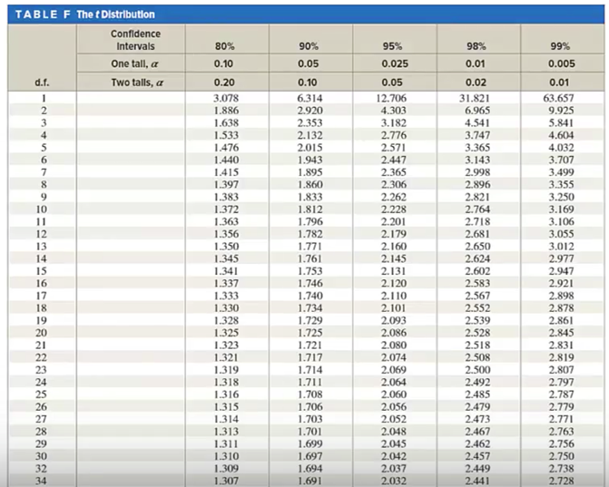
t Distribution
Looking at the t-table, we have confidence levels for confidence intervals

Slide 6
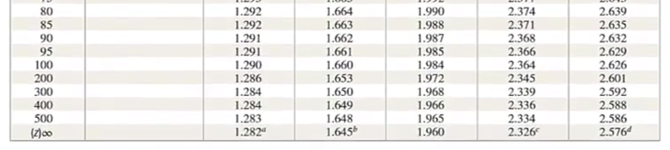
Bottom Row of t Table
On the bottom row we have z values.
If we are to calculate a sample size required for a 95% confidence level. We will look at the 95% column and go to the very bottom where we find a value of 1.96.

Slide 7

Calculation (1)
$$n={\left(\frac{z_{\frac{α}{2}}∗σ}{E}\right)}^{2}$$
E is the margin of error. The problem specifies a precision of $35.
$σ$ is the symbol for the standard deviation population
If the standard deviation from a previous study of the same population is available it may be used in this formula. If that is unavailable but the range is known, then the standard deviation can be estimated by dividing the range by 4.

Slide 8

Calculation (2)
In this case the maximum value is estimated to be $850 and the minimum is estimated to be $150. The range will be 700 which we will divide by 4 for a value of $175.
$$σ≈\frac{R}{4}=\frac{850−150}{4}=\frac{700}{4}=175$$
This will be our estimate for the standard deviation for this application.
Substitute these values into the formula
$$n={\left(\frac{z_{\frac{α}{2}}∗σ}{E}\right)}^{2}={\left(\frac{1.96∗175}{35}\right)}^{2}=96.04$$

Slide 9
Estimating Sample Sizes
It is obviously impossible to sample only part of a unit. So when estimating sample sizes, it is necessary to always round up in order to avoid compromising precision and confidence. The appropriate sample size should be 97.

Slide 10
Summary
In this PowerPoint, we learned How to calculate the minimum sample size needed for an interval estimate of a population mean

